Slide 1
Lung Cancer Prediction
Data Analysis
Samia Mahmood

Slide 2

What is Lung Cancer?
A type of cancer that begins in the lungs and spreads to other organs of the body.
2nd most common form of cancer worldwide with at least 2.2 million cases reported per year.
Lung cancer comes in two forms, non-small cell lung cancer and small-cell lung cancer.
The World Cancer Research Fund Institute has found that lung cancer is the most common type of cancer for men and the second most common type for women.

Slide 3
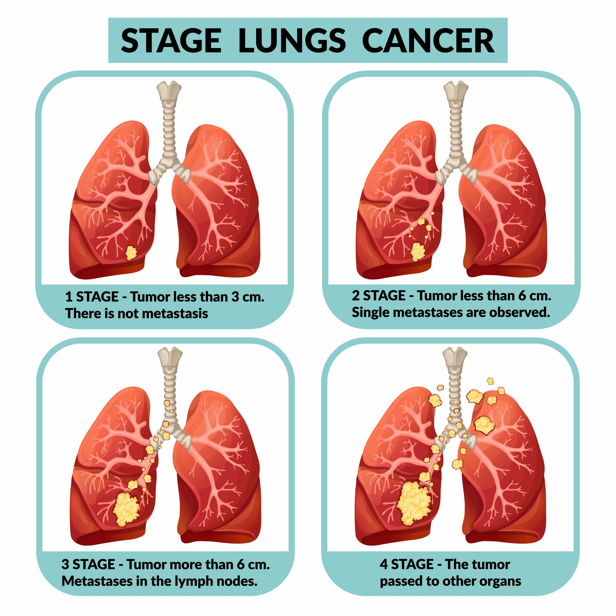
What is Lung Cancer?

Slide 4

Background on the Dataset
The authors of this dataset referenced a study published by the Nature Medicine Journal which collected data from 462,000 people in China over a six-year period.
The population was divided into two groups.
One group was for those in areas with high air pollution while the other group for those living in areas with low air pollution.

Slide 5
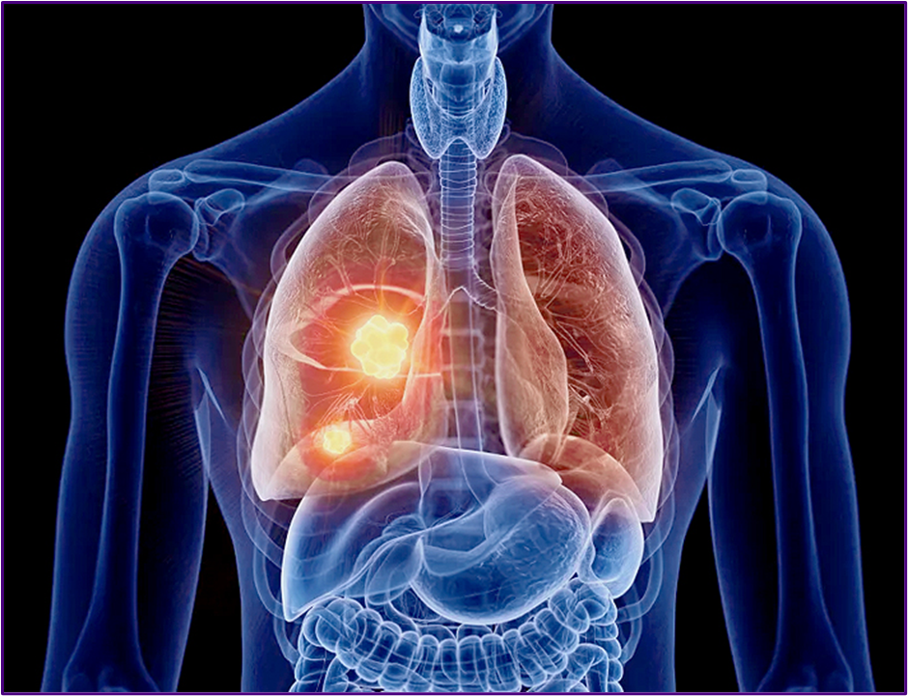
About Dataset
This dataset was from Kaggle.
The dataset contains 1000 rows and 26 columns.
There were no missing values within the dataset.
The Y variable for this dataset was the “Level” variable.
Which refers to the likelihood or chance of developing lung cancer.

Slide 6

Overview of the Dataset
Variable Name | Data Type | Missing Data (%)
index | int64, ratio | 0%
Patient Id | Object, nominal | 0%
Age | int64, ratio | 0%
Gender | int64, ratio | 0%
Air Pollution | int64, ordinal | 0%
Alcohol use | int64, ordinal | 0%
Dust Allergy | int64, ordinal | 0%
OccuPational Hazards | int64, ordinal | 0%
Genetic Risk | int64, ordinal | 0%
chronic Lung Disease | int64, ordinal | 0%
Balanced Diet | int64, ordinal | 0%
Obesity | int64, ordinal | 0%
Smoking | int64, ordinal | 0%
Passive Smoker | int64, ordinal | 0%
Chest Pain | int64, ordinal | 0%
Coughing of Blood | int64, ordinal | 0%
Fatigue | int64, ordinal | 0%
Weight Loss | int64, ordinal | 0%
Shortness of Breath | int64, ordinal | 0%
Wheezing | int64, ordinal | 0%
Swallowing Difficulty | int64, ordinal | 0%
Clubbing of Finger Nails | int64, ordinal | 0%
Frequent Cold | int64, ordinal | 0%
Dry Cough | int64, ordinal | 0%
Snoring | int64, ordinal | 0%
Level | Object, ordinal | 0%

Slide 7
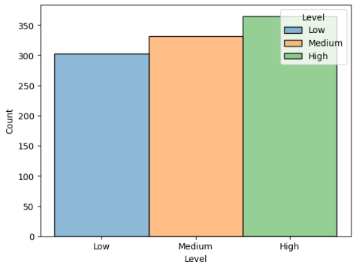
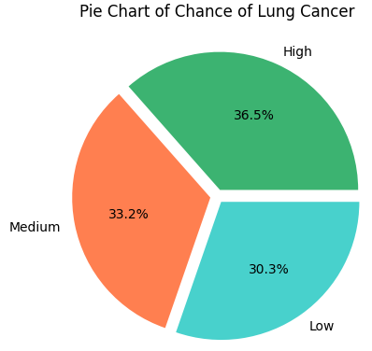
Distribution of the Y Variable “Level”

Slide 8
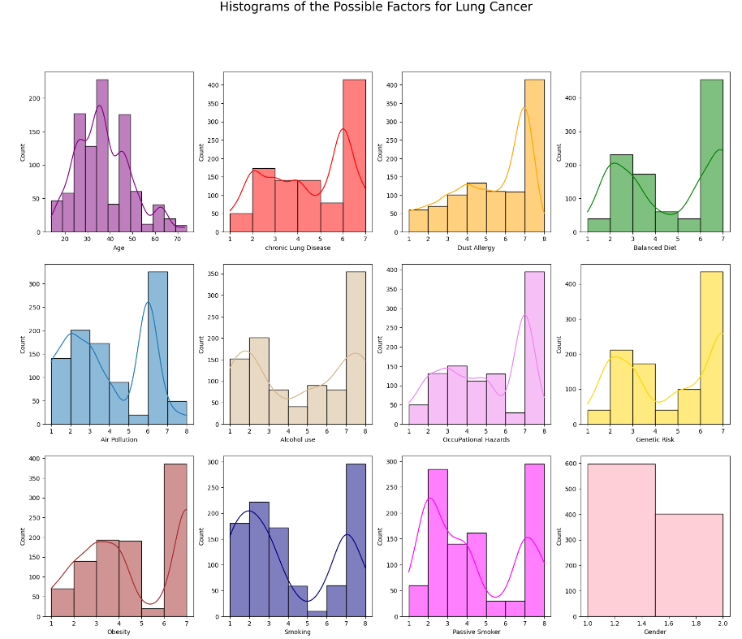


Slide 9
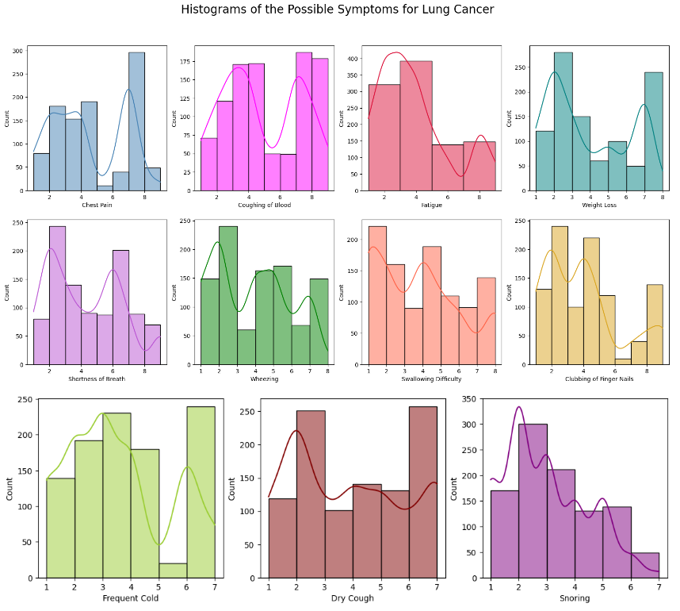

Slide 10

What I’m Trying to Predict and Find
To predict the likelihood of a patient developing lung cancer given different factors and symptoms provided by the patient.
Identifying the factors and symptoms are highly correlated with lung cancer.
Seeing if smoking could be a leading contributor to developing lung cancer by checking how well it correlates with the level.

Slide 11
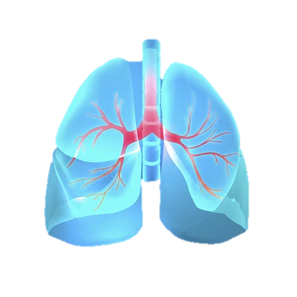
Data Cleaning and Preparation
Deleted two columns, “Index” and “Patient Id” since it was not needed for this data analysis.
For creating my correlation matrix - wanted to see which factors and symptoms would be the most associated with my Y variable “Level.”
Made a copy of my original dataset and gave integer values 0, 1, and 2 to the various levels low, medium, and high.

Slide 12

Data Cleaning and Preparation
For my logistic regression model, since the “Level” variable was categorical, a label encoder was used onto the original dataset.
This encoded the various levels into integer values 0, 1, and 2 to correspond with low, medium, and high, respectively.

Slide 13
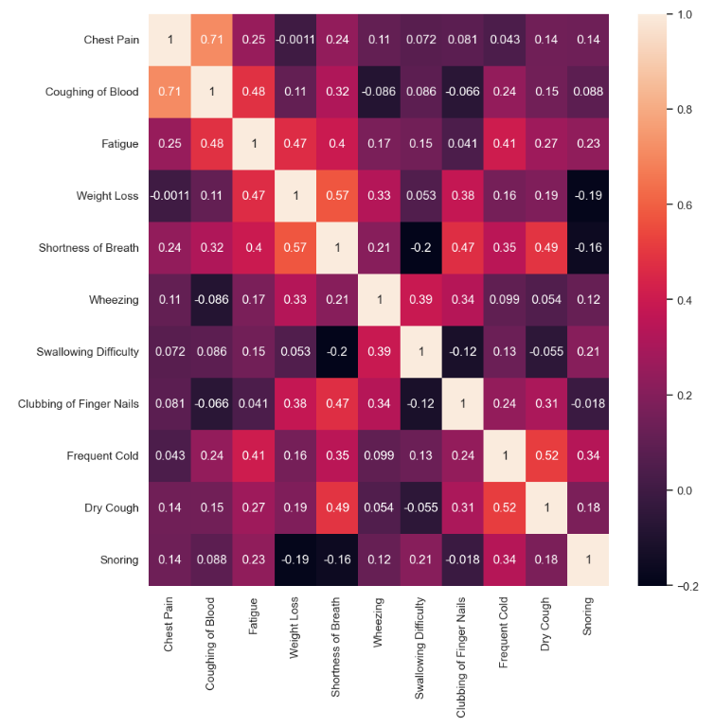
Heatmap for Symptoms
Very high positive correlation between coughing of blood and chest pain.
Somewhat high positive correlations between:
fatigue and coughing up blood.
fatigue and weight loss.
shortness of breath and weight loss.
shortness of breath and clubbing of fingers.
shortness of breath and dry cough.
dry cough and frequent cold.

Slide 14
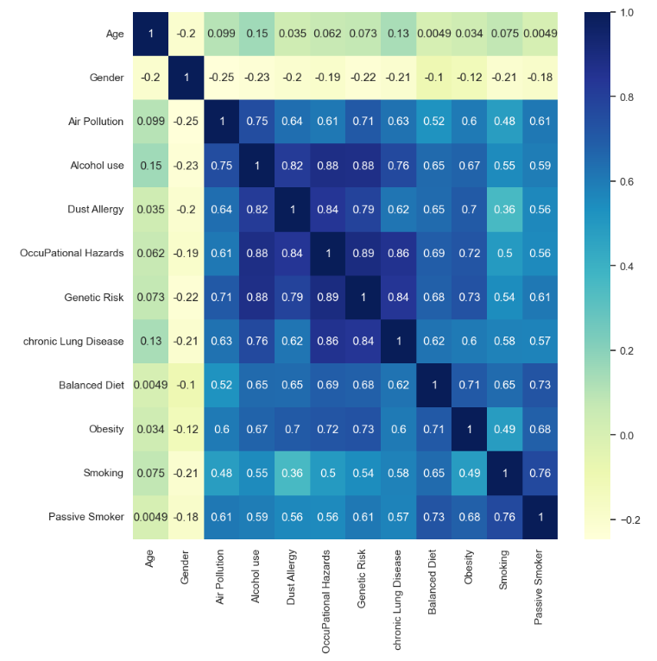
Heatmap for Factors
Age and gender have no correlation with the other factors.
All the other factors seem to have a somewhat strong to very strong positive correlation with one another.
Except for the correlation of smoking and dust allergy.

Slide 15
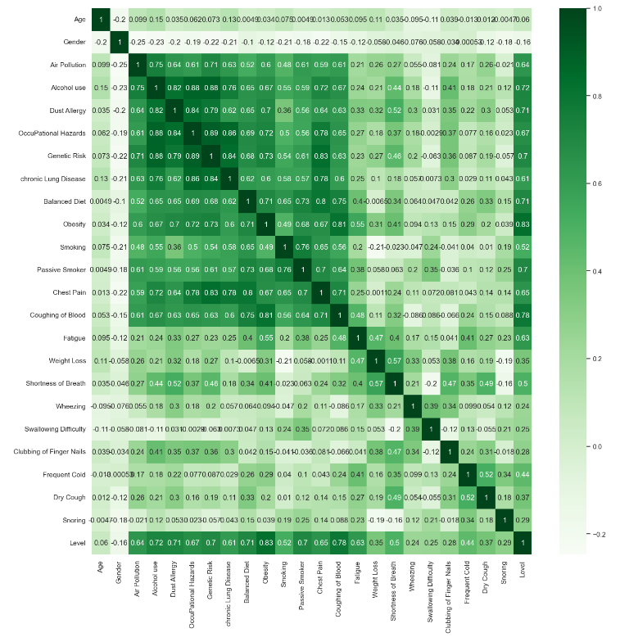
Correlation Matrix
Very high positive correlation with levels of the following factors:
obesity
air pollution
alcohol use
dust allergy
occupational hazards
genetic risk
chronic lung disease
balanced diet
passive smoker
Relatively high positive correlation with levels of the following factors:
Smoking
Notes:
Surprisingly, though smoking was somewhat highly correlated at 0.52, it was not as much of a leading factor for high level of lung cancer as I had initially assumed. Therefore, it is not worth testing alone for my regression model

Slide 16
Correlation Matrix
Very high positive correlation with levels of the following symptoms:
coughing of blood
chest pain
fatigue
Relatively high positive correlation with levels of the following symptoms:
Shortness of breath

Slide 17
Creating Logistic Regression Models
For the first three experiments, the dependent variable as “Level” and the independent variable as all the other variables within the dataset.
For the fourth experiment, the independent variable was all the highly correlated variables with Level.
The dataset was split into the training set and test set with varying test sizes for each experiment.
The random states were kept constant at 0 for all experiments.
Then the logistic regression model was trained on the testing set.

Slide 18
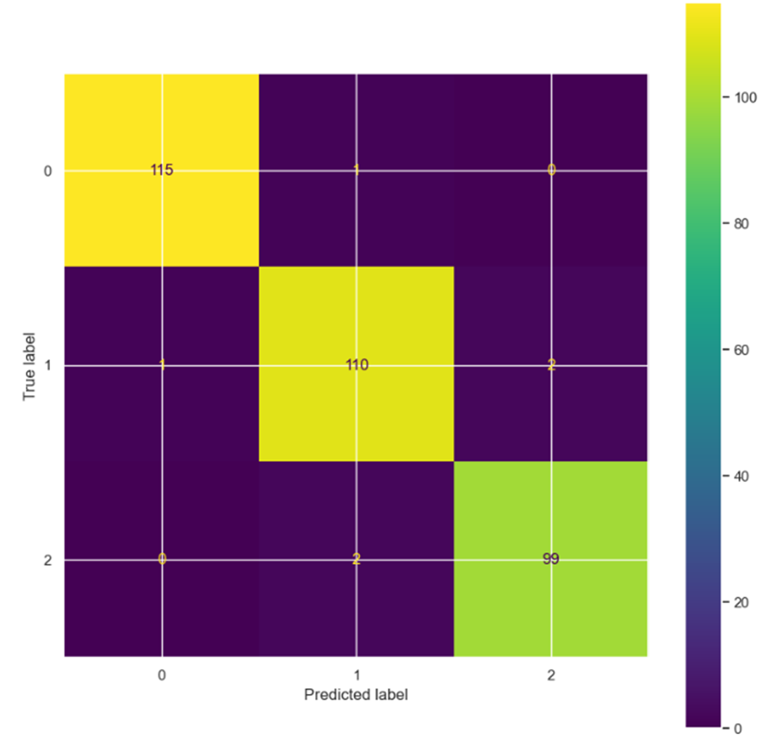
Logistic Regression Models
Experiment 1
Test size = 0.33
67/16.5/16.5 split for train, validate, and test
All the variables were used.
The model performed very well.
Only 6 patients were incorrectly predicted.
115 correctly predicted low.
110 correctly predicted medium.
99 correctly predicted high.

Slide 19
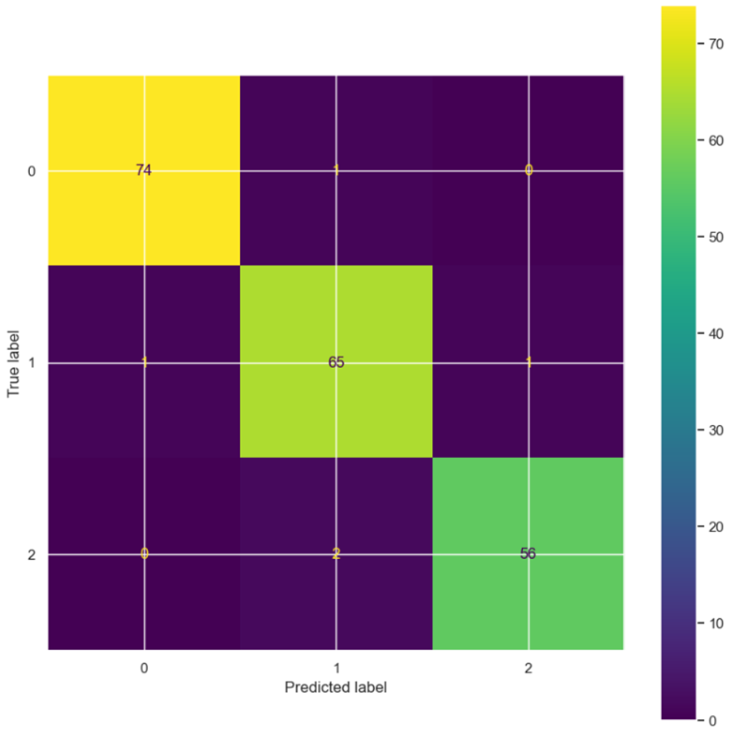
Logistic Regression Models
Experiment 2
Test size = 0.20
80/10/10 split for train, validate, and test
All the variables were used.
Performed well.
Only 5 patients were incorrectly predicted.
74 correctly predicted low.
65 correctly predicted medium.
56 correctly predicted high.

Slide 20
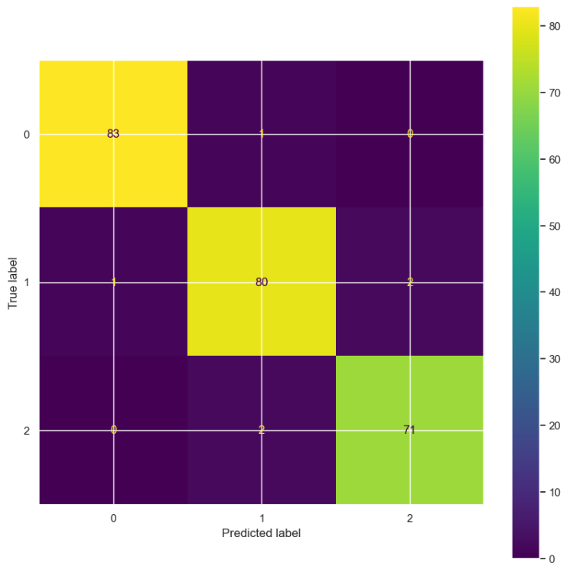
Logistic Regression Models
Experiment 3
Test size = 0.24
70/12/12 split for train, validate, and test
All the variables were used.
Performed well.
Only 6 patients were incorrectly predicted.
83 correctly predicted low.
80 correctly predicted medium.
71 correctly predicted high.

Slide 21
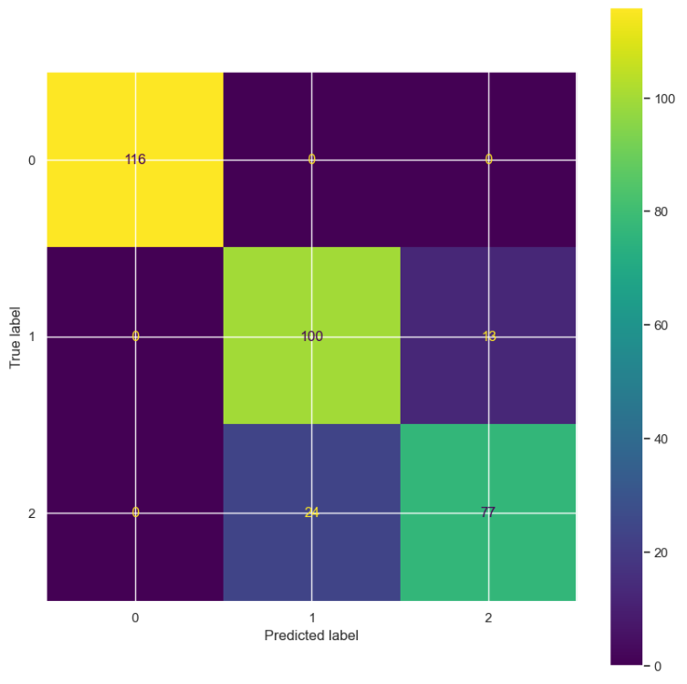
Logistic Regression Models
Experiment 4
Test size = 0.33
67/16.5/16.5 split for train, validate, and test
Filtered data with the most highly correlated variables with Level
Performed decently.
37 patients were incorrectly predicted.
116 correctly predicted low.
100 correctly predicted medium.
77 correctly predicted high.

Slide 22


Results
Experiment 1, experiment 2, and experiment 3 all performed very well with most of the predicted values matching the actual values.
Experiment 4, with the most highly correlated variables, surprisingly performed worse than the previous three experiments.
Each variable of the entire dataset may be important contributors to the effectiveness of the regression model.
Experiment 1 performed the best given it had the highest accuracy of 98%.
Experiment 2 and experiment 3 had an accuracy of 97% each.
Experiment 4 had an accuracy of 89%.
The dataset was balanced.
Notes:
Based on all 4 correlation matrixes….
Moving forward, experiments for this dataset should include all the raw features for its regression model.
Based on the classification reports…..

Slide 23


Problems Encountered and Future Work
There were initial problems regarding data visualization for histograms.
For the future, perform an experiment with the most correlated factor “Obesity” or symptom “Coughing of Blood”.
Continue to perform experiments using all the raw data but with new test sizes to see any differences.
Notes:
In the future, I would like to perform an experiment with the most correlated factor “Obesity” or symptom “Coughing of Blood”.
I want to continue to perform experiments using all the raw data but with new test sizes to see any differences.

Slide 24

Conclusion
Successfully identified the factors and symptoms that can predict the likelihood of developing lung cancer.
Found the most correlated variables.
The factor that had the highest correlation with the level was obesity.
The symptom that had the highest correlation with the level was coughing up blood.
Smoking was not a leading factor.
Overall, the models performed extremely well.
Experiment 1 performed the best (98% accuracy and 6 incorrect predictions)
Experiment 2 did well (97% accuracy and 5 incorrect predictions)
Experiment 3 did well (97% accuracy and 6 incorrect predictions)
Experiment 4 did decent but performed the worst (89% accuracy and 37 incorrect predictions)
These models can accurately help predict the likelihood of a patient developing lung cancer.

Slide 25

Thank you!

